Slide 1

Blue Bear Systems Research
Soar for Real Applications
Dr Phill Smith
24th Soar Workshop
9th – 11th June 2004
Building 32, Twinwoods Business Park, Clapham, Bedfordshire MK41 6AE
Tel: 01234 212001 Email: phill@bluebearsystems.com
✓ www.bluebearsystems.com

Slide 2
Autonomous Systems
  Autonomous systems are ready for Soar….
  …. Is Soar ready for autonomous systems?

Slide 3
NO!

Slide 4
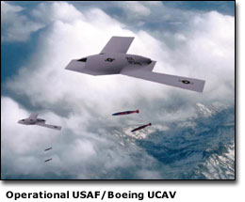
Vehicles – air

Slide 5
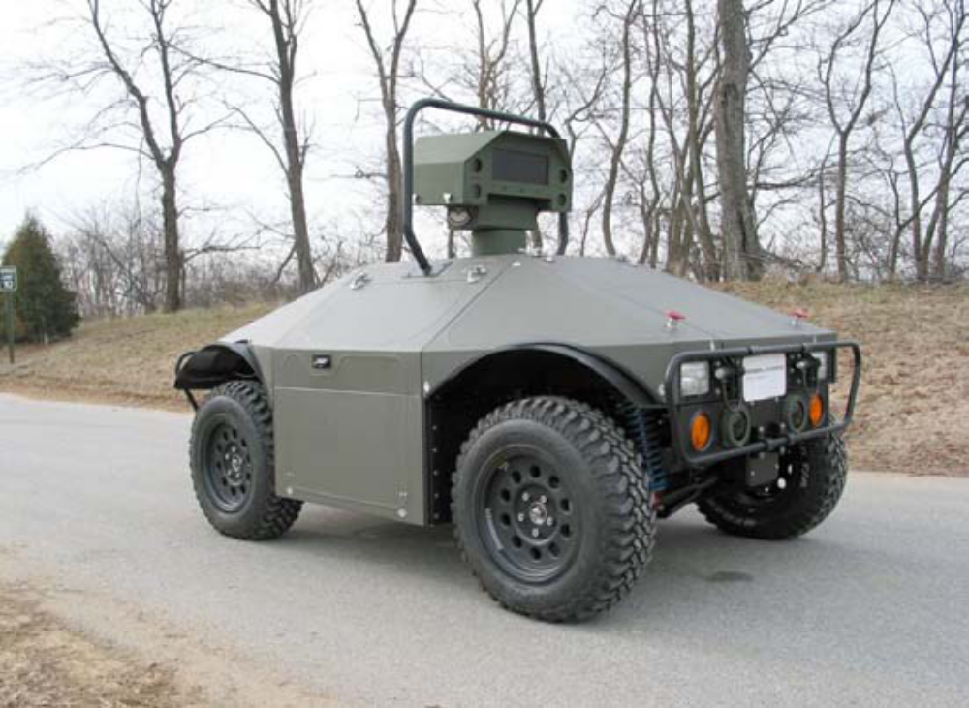
Vehicles - ground

Slide 6
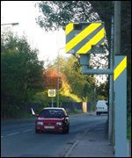
Static Systems

Slide 7
Soar Nuisances
I can’t count
Copying a complex data object from one place to another is painful
Unwanted & duplicate matches
Question marks over learning capabilities
Memory leaks?
Integration into applications
Development environment……………

Slide 8
Soar good stuff
You can do a lot with it
Runs real-time
Applicable to autonomous systems
Solve the problems and there are many applications for real systems

Slide 9
What’s it going to take?
Needs:
  All the stuff Simon Willcox will talk about first thing tomorrow
  Integrity
  Credibility
  Software certification
  Track record
  Demonstration of above
  Commercial support
  A determined effort to secure funding targeted at development for autonomous systems
  A Soar “Grand Challenge”

Slide 10

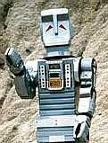
Stop, End, Finish
Marvin:
  “…. a sort of electronic sulking machine”

